Slide 1
Presentation to Metropolitan Transport Forum
Mike Davidson
Australian Energy Market Operator
22nd August 2024
Notes:
All data updated to 31 December 2023

Slide 2
We acknowledge the Traditional Owners of country throughout Australia and recognise their continuing connection to land, waters and culture.
We pay respect to their Elders
past, present and emerging.

Slide 3
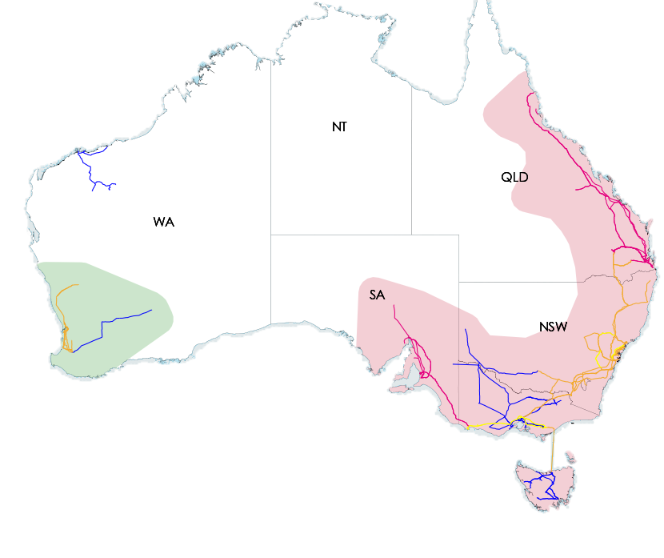
National Electricity Market (NEM)
Population 22.8 million
NEM Max Demand 35,796 MW
NEM Min Demand 11,009 MW
Wind Capacity 11,392 MW
Solar Capacity 9,644 MW
Rooftop Solar Capacity 19,895 MW
Approximately 3 million homes have a solar system
The NEM
Energy & Freq market
40,000 km of transmission
Supplies ~11 million customers
71 GW on generation capacity
VIC
TAS
Notes:
As a starting point, let’s take a look at the NEM by the numbers –
The NEM is the long, interconnected transmission system highlighted in the pink area – which supplies electricity to almost 23 million people in Australia across five regions: QLD, NSW, VIC, SA & TAS.
On a NEM-wide basis, instantaneous demand for electricity has reached a maximum of ~35,800 MW (back in 2009) and a minimum of ~11,900MW (much more recently, in November 2022).
The capacity of grid-connected wind generation has grown to 10,259MW, and utility solar to 8,901MW.
The capacity of distributed rooftop PV has now exceeded 17 GW – almost double that of utility solar – with approximately 3 million homes across the NEM now with installed rooftop PV systems.
About the data:
NEM Max/Min demand = operational demand
Wind Capacity (registered capacity) = semi-scheduled wind + significant non-scheduled wind farms (>30MW) and non-scheduled wind farms <30MW by exception (Mortons Lane WF, Yaloak South WF)
Solar Capacity (registered capacity) = semi-scheduled solar + non-scheduled solar farms <30MW by exception (Hughenden SF and Long Reach SF).
Rooftop solar capacity= #OPF_LMT\Report\ANEMOS\ASEFS2\ASEFS2 Installed Capacity - Select By Region/NEM
Homes with solar systems = 2,985,279

Slide 4
Growth in Variable Renewable Energy
NEM Generation capacity (91 GW)
Notes:
Included now is the annual growth of NEM-wide distributed rooftop PV capacity (DPV) – made up of the DPV systems ≤ 100kW.
In terms of installation rate, DPV has had a similar growth trend to wind & solar - increasing by ~10,000MW between 2018 and ’22.
In total - wind, utility-solar & DPV capacity has grown from 7,900MW at the end of 2015, to 36,200MW at the end of 2022 – and continues to increase as more people install rooftop PV systems, and large wind and solar projects are added to the NEM.

Slide 5
Growth in Distributed Rooftop PV (DPV)
DPV Systems up to 100 kW
Peak Load
14 GW
10 GW
3 GW
2 GW
10 GW
DPV Pen*
54 %
53 %
102 %
19 %
66 %
* DPV Penetration (%)
An estimate of the total instantaneous demand in a region being supplied by rooftop PV generation
Notes:
Headline: DPV has increased significantly across the NEM since 2017 now meeting up to 93% of South Australia's electricity needs
Points to hit:
Uptake drivers: Government rebates / feed-in tariffs / cheaper technology / small-scale renewable energy certificates / increasing retail price increase / home investment during COVID
Sunnier regions in NSW & QLD have the highest capacity
SA is relatively smaller than NSW & QLD but has the highest penetration during the middle of the day
Key take-aways / questions for audience:
Additional stats and information:
Peak demand typically occurs during the evening when there is little to no DPV.
DPV penetration is highest during the middle of the day, during mild “goldilocks” condition and low underlying demand
DPV has met total scheduled demand in SA at a 5-minute level

Slide 6
NEM Rooftop PV Growth
The level of rooftop PV generation in the NEM has increased across the years due to growth in installed capacity. It also follows a seasonal pattern – highest in summer and lowest in winter.
NEM Rooftop PV capacity (MW)
Notes:
In addition to day-to-day variation, DFS models also factor in the growth in rooftop PV over time, and the changes in generation levels across each year.
Shown here is the estimated rooftop PV generation in the NEM since 2017, this highlights:
The general growth in PV over time – due to the increase in installed capacity on homes and business, and
The seasonal pattern – driven by the availability of solar irradiance across the year – highest during the summer months and lowest during the winter months.
Due to the distributed nature of rooftop PV and the diversity of weather, the regional rooftop PV is limited by it’s capacity factor:
This is a measure of the maximum PV availability – expressed as total PV generation as a percentage of total installed capacity for that region.
The upper limit of capacity factor for any NEM region is ~75%, observed in summer, and drops to as low as ~45% during winter.
This means that if a region has 1,000MW of installed PV capacity it can only generate up to 750MW during the peak of summer.

Slide 7
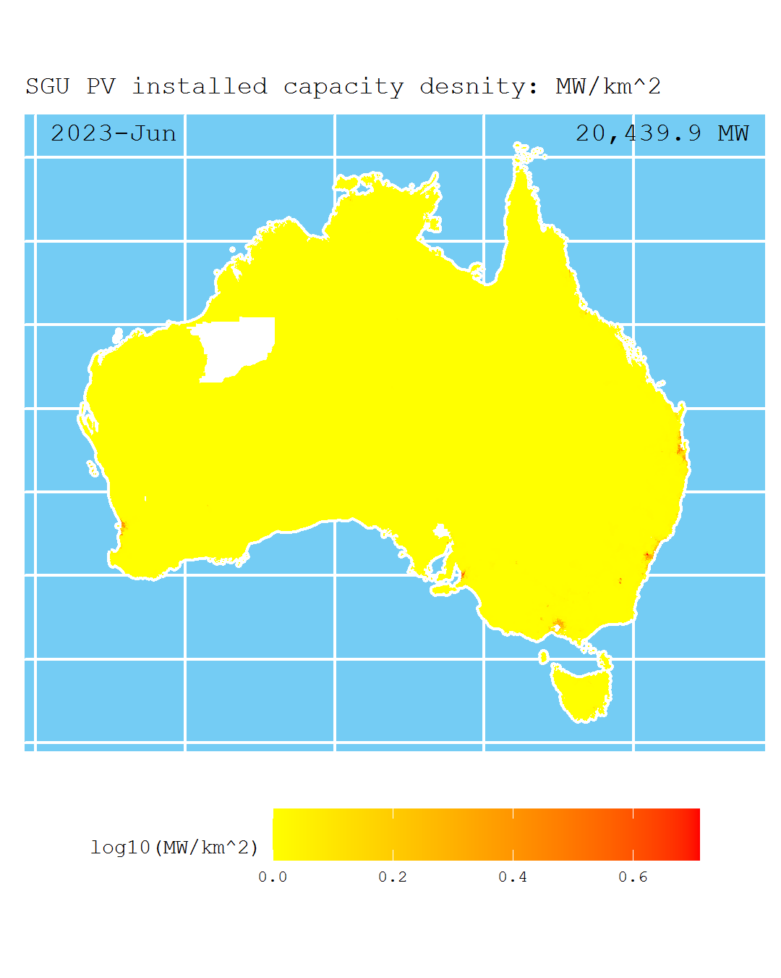
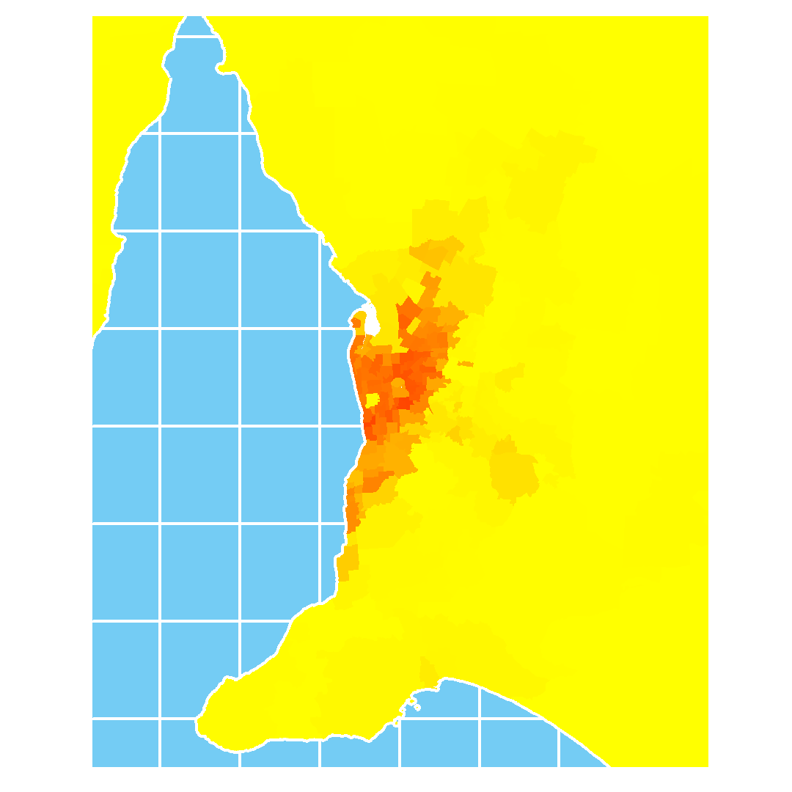
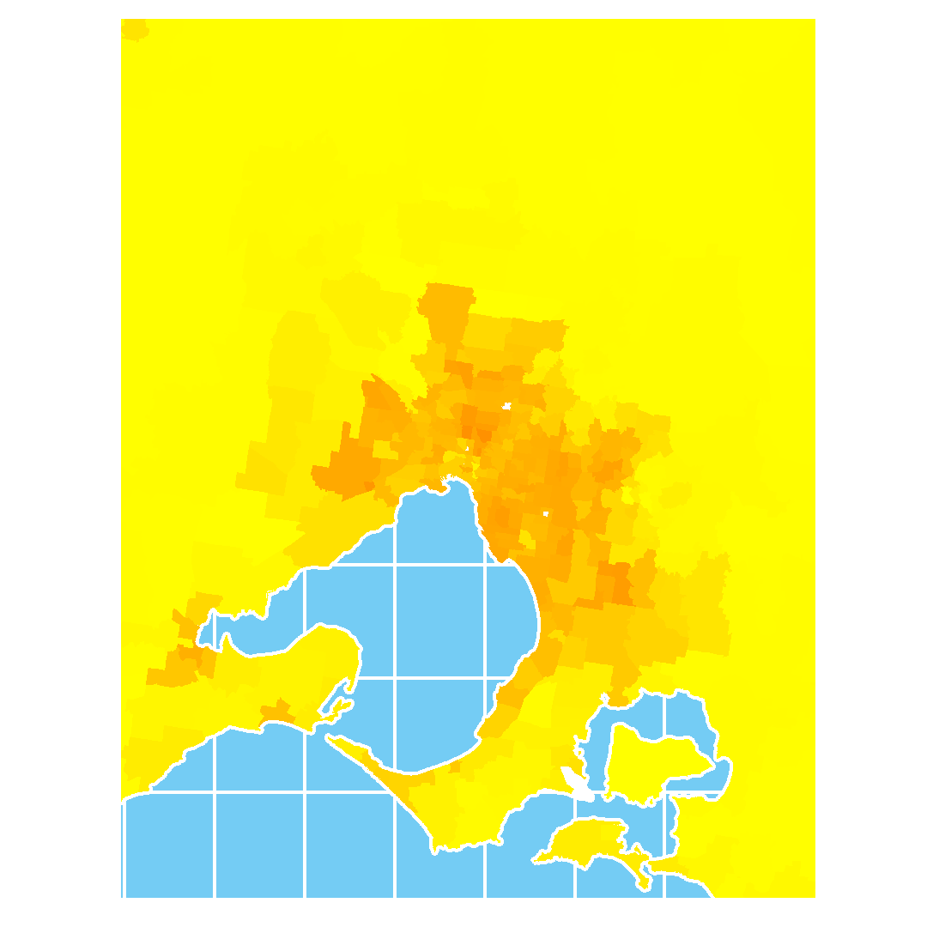
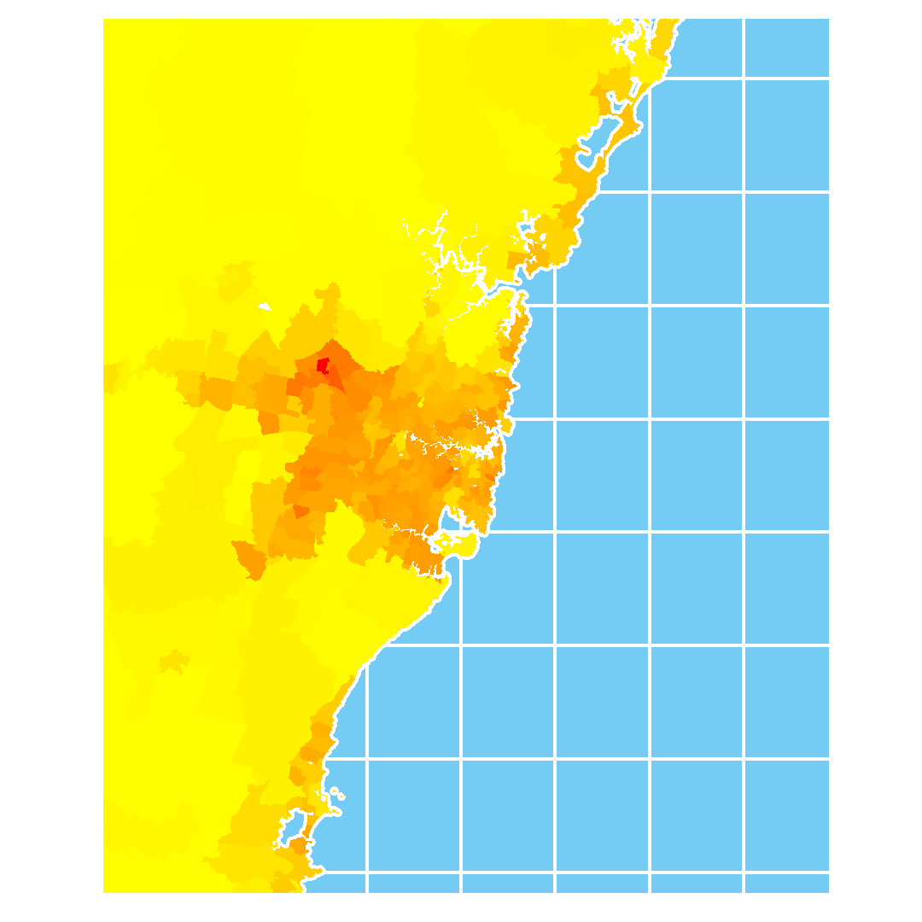
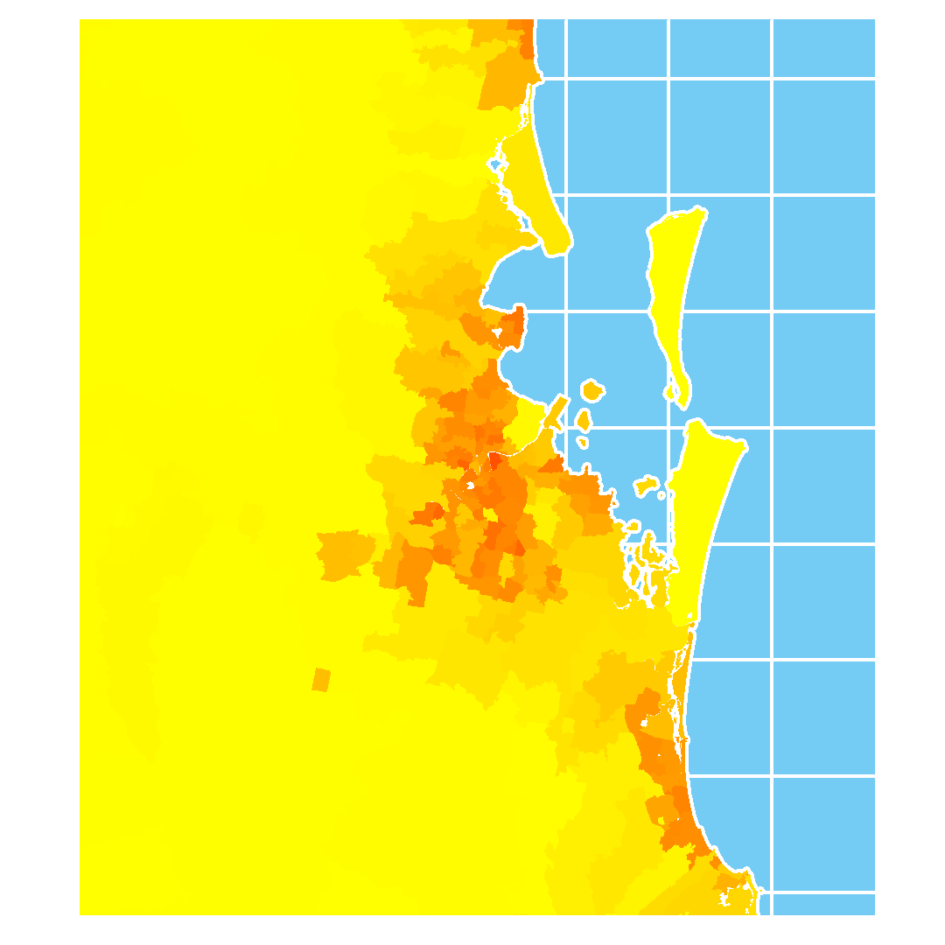
Growth in Distributed Rooftop PV (DPV)
Adelaide (SA)
Melbourne (VIC)
Sydney (NSW)
Brisbane (QLD)
Notes:
Headline: Rooftop PV density is most concentrated in metropolitan areas and therefore is vulnerable to weather system moving through these areas
Points to hit:
Called Distributed PV but in reality they act as very large metro solar generators – largest by capacity in every NEM region
Adelaide has the highest density of rooftop PV systems (deepest red on the heat map)
Cloud bands can sweep across these metro areas and supress DPV quickly (discuss later)
Key take-aways / questions for audience:
Additional stats and information:

Slide 8
Evolving Shape of the Demand Profile
Notes:
Let’s now switch focus to electricity demand – and take a look at how the NEM demand profile has evolved since 2010.
The main driver of changing demand across this time is the growth in DPV – which offsets measured operational demand during the daylight hours.
Another factor is the reduction in large industrial demand – which is largely independent of PV impacts.
Looking at the evolution, major changes included:
The reduction in average demand between 2011 and 2012, noticeable during overnight and evening hours – which was due to the shut-down of the Kurri-Kurri smelter in NSW.
The earlier and lower morning peaks between 2012 and 2022, and
The much lower daytime demand – with the midday trough decreasing almost 6,000MW on average between 2010 and 2022.
It should be noted that while average demand is lowest for overnight periods in this chart - all NEM regions except Tas now see their lowest instantaneous demand in the middle of the day.

Slide 9
Daytime Minimum Demand Records
Minimum Operational Demand records in South Australia since 2018
20 GW of Distributed PV (DPV) capacity in the NEM.
DPV is distributed, largely passive, and operationally “invisible”
Growth in distribution connected capacity is changing the shape and trend in operational demand.
DPV curtailment and activated DER is starting to slow the reductions in daytime demand
Min demand
599 MW
458 MW
300 MW
104 MW
100 MW
-26 MW
DPV capacity
967 MW
1,182 MW
1,510 MW
1,826 MW
2,053 MW
2,374 MW
Notes:
Since DPV generation is invisible, passive, and acting in large amounts – it’s driving operational demand to record low levels during the daytime across the NEM.
As mentioned, SA has the highest DPV penetration of any region – such that now, the minimum operational demand observed in SA is only 100MW –
The remaining mainland regions - VIC, NSW & QLD – have also recently observed minimum demand records during the middle of the day – which are all expected to further decrease in years to come.

Slide 10
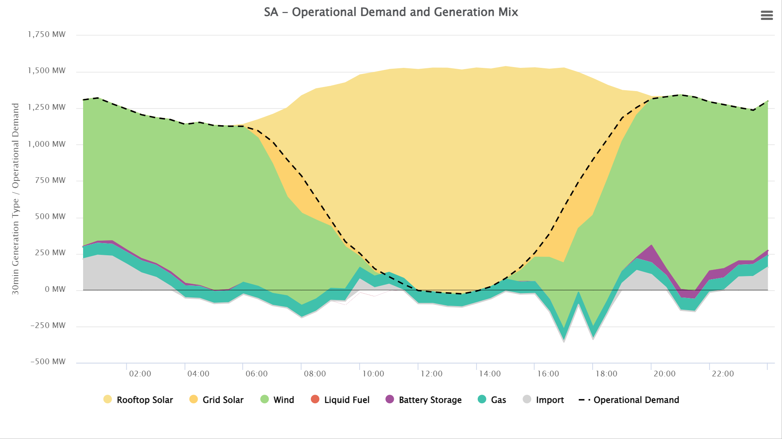
SA Minimum Demand Record
New SA Minimum Operational Demand Record: -26 MW at 1330 hrs

Slide 11
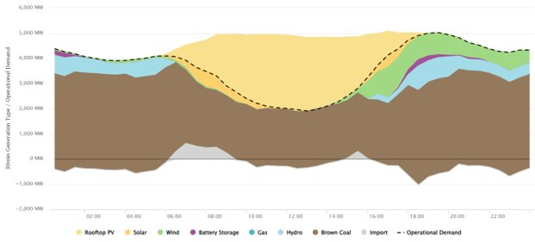
Victorian Minimum Demand Record

Slide 13
Growth in Variable Renewable Energy
The amount of energy from DPV and VRE has increased over time and is approaching the energy provided by conventional coal.
Daily Coal (MWh)
Daily Energy (MWh)
Daily VRE + DPV (MWh)
Notes:
Headline: The energy transition: Energy provided from intermittent generation sources is on a collision course with conventional, aging coal generation.
Points to hit:
November 2022 was the first time daily energy from Intermittent gen sources equalled coal
Trends accelerate as coal fired generators are closing down earlier than anticipated:
Lower cost intermittent gen is reducing market price therefore less profit for coal
Technical challenges and limitations for aging coal fleet requiring maintenance
As the reliance on VRE increases forecast accuracy will become increasingly important
Key take-aways / questions for audience:
The trend in daily energy (MWh) from coal and intermittent generation (VRE + DPV) 2016 to 2023
The amount of energy from IG is increasing and coal decreasing, leading to a transition in supply
Additional stats and information:

Slide 14
Evolving Shape of the Demand Profile
While the shape of the operational demand profile has evolved through the years, the shape of underlying demand or total consumption has not materially changed.
Average NEM Operational Demand
Average NEM Underlying Demand
Operational demand (MW)
Notes:
When accounting for the growth in rooftop PV over time – we can visualise the change in “underlying demand” over time.
Shown here is the comparison between measured operational demand (left) and underlying demand (including rooftop PV) (right) between 2010 and 2022.
This highlights that while rooftop PV has had a significant affect in changing the measured demand profile - underlying consumption hasn’t actually changed that much.

Slide 15
DFS Model Variables: Rooftop PV
Rooftop PV generation is an estimated behind-the-meter (BTM) resource. When generating, it offsets grid-connected generation and inversely impacts daytime operational demand. Daytime demand can be low, high, or variable, depending on rooftop PV output across a day.
No Cloud
Intermittent Cloud
Full Cloud
Operational Demand / Rooftop PV (MW)
Notes:
The next DFS model variables is rooftop PV generation – the most powerful variable in forecasting daytime demand in the NEM.
Since rooftop PV is a behind-the-meter generation resource, it offsets grid-connected generation and therefore inversely impacts daytime operational demand.
The influence on operational demand can be seen in the three days shown here – which represent the three day-type classifications for rooftop PV:
Left: No cloud - clear sky day – These conditions allow rooftop PV to generate at a maximum for that time of year, and can lead to very low daytime demands given favourable weather conditions.
Right: Full cloud day – where constant and widespread cloud suppress rooftop PV to low levels, increasing daytime demand towards “underlying demand”.
Middle: Intermittently cloudy day –
There can occur when a cloud band passes over a metro area, quickly suppressing a large amount of PV on an otherwise sunny day.
These conditions are the most challenging to forecast and can cause large up and down ramps in demands.
The impact of this is explored in more detail the Managing Operational Forecasts module.

Slide 16
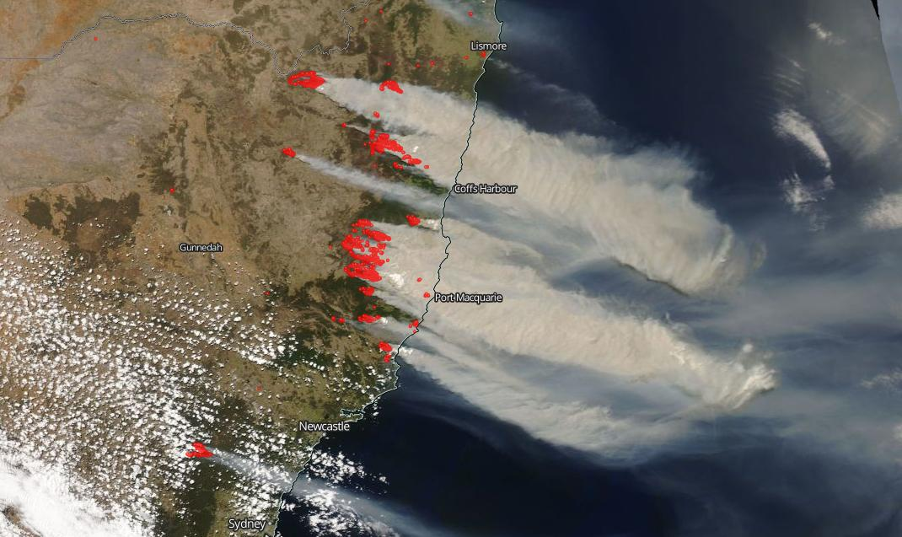
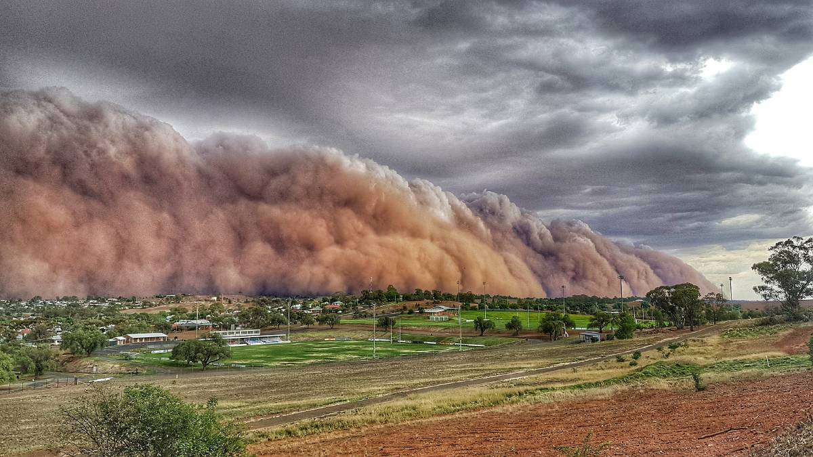
Extreme Weather Impacts
2019-2020 Summer bushfires saw extensive attenuation of solar farm and rooftop PV output due to smoke
Dust storms impact on demand as well as Distributed and Utility Scale PV

