Slide 1
MTF Online forum EVs and their infrastructure
ross de rango
head of energy and infrastructure

Slide 2
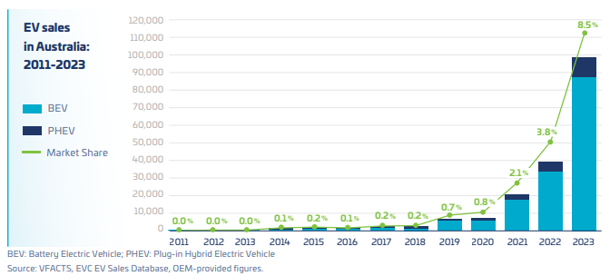
EV sales in australia

Slide 3
 | Standalone home with off street parking (~75%) | Strata development with allocated off street parking (~15%) | Housing without off-street parking (eg, terrace house (~10%)
Owned (~68%) | Very Easy. Existing powerpoint ($0). Install a charger ($2k) | Difficult. Requires majority agreement within body corporate, and a plan…. | Very difficult. Trials underway, looking at wiring under the footpath.
Renter (~32%) | Relatively easy. Existing powerpoint ($0) With landlords pemission, charger ($2k) | Very difficult. Same as above, but the resident does not have direct standing to make the case. | Almost impossible. These people most likely to use public charging infrastructure instead.
Not much help needed here!
NCC2022 changes will help here
Public charging will help here
housing mix, tenure type – installing charging at home

Slide 4
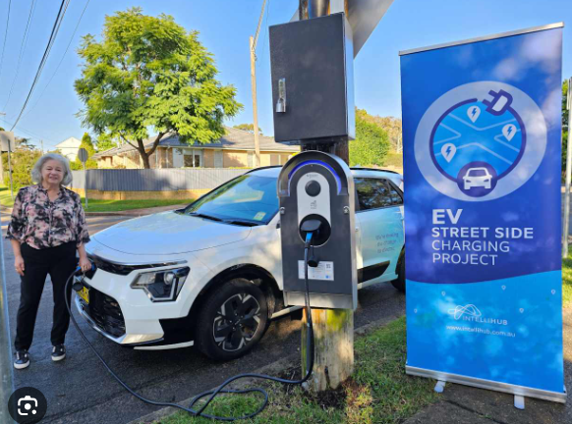
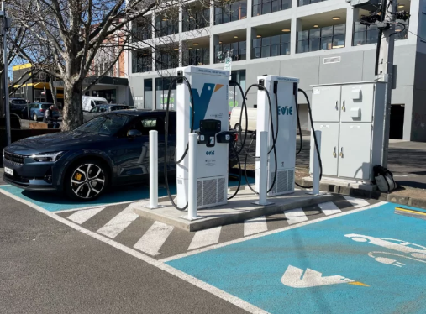
Pole mounted chargers
Collaborate with CPO & DNSP
Support with community engagement
Recharging time: 4 to 8 hours
Fast chargers
Zero cost leases for car parking space
Support with community engagement
Recharging time: 15 to 60 minutes
Key Roles for local government in public EV charging

Slide 5
Google: EVC Guidelines
Recommended DCPs for apartments.
Compilation of installation rules.
Maximum demand determination materials.
Google: EVC Consumer Hub
Lifecycle emissions, cost calculator, home charging guide, etc etc.
Coming soon:
Retailer comparison tool, helping drivers find good deals for home charging.
LGA / CPO template lease agreements, supporting public charging deployments
RESOURCES

